Slide 1

CPA150 – 5G pulse accumulator
04/11/2022

Slide 2
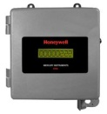
CPA150 | Pulse Accumulation made SIMPLE
5mn start-up
2 Way communication (Periodic & On-Demand)
8 years battery life
Class 1 Div 2
“Real Time” volume & battery alarms
Integration with leading MDM/SCADA - PowerSpring
TLS 1.2
GPS

Slide 3
CPA150 Dual-Channel Pulse Data Logger
Designed for C&I Smart Metering/AMI Analog
The CPA150 is a Cat M1 / NB-IoT, battery-operated, easy to configure dual-channel pulse data logger designed to support most commercial & Industrial (C&I) smart metering/automatic meter reading (AMR).
The CPA150 Pulse Data Logger is designed for low-power and outdoor operation. It is ideal for call-In applications involving meter data management (MDM) and can directly connect to PowerSpring or couple with the InvisiConnect software or an MQTT bridge to interface with third-party MDM systems.
The CPA150 is fully integrated in the Honeywell ecosystem and is easy to program through its USB communication port and associated configuration software.
The CPA150 is CSA Class I Div 2 approved, making it a perfect solution for gas measurement applications where safety is always a concern.

Slide 4
CPA150
Inputs / Outputs :
  2 Digital Inputs
  1 Pulse Output
LTE CAT M1 connectivity
  Optimized for low data usage
  eDRX support
Call Frequency :
  Configurable call frequency : mins → hours
Alarms
  Real time (eDRX).
Internal / External antenna
Integration with :
  PowerSpring and any SCADA talking MQTT SparkPlug B or OPC DA through AutoSol Bridge.
8 years battery life with hourly calls.
Data location from built-in GPS.
Class 1 Division 2 Certified.
Compatible with Canadian Carriers
Operating Temp: -40°F → +185°F
(-40°C → 85°C).
Notes:
32 data points, up to 8 devices, 18V, 60mA

Slide 5
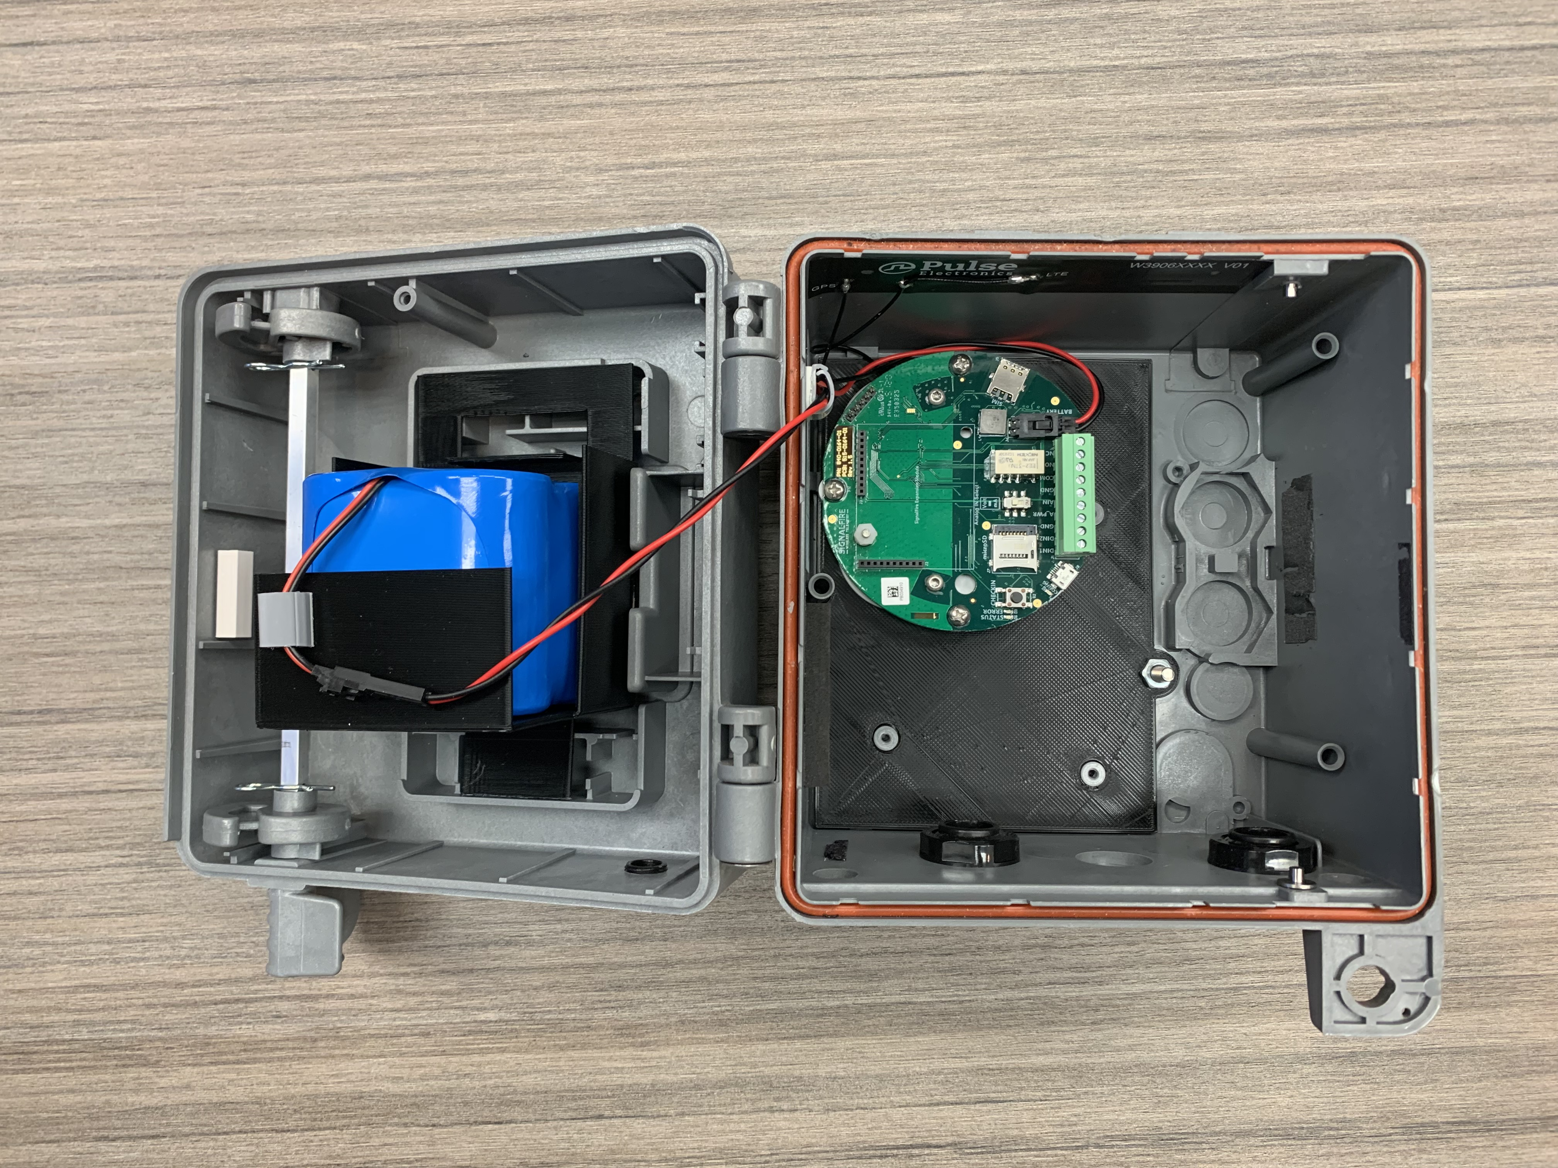
CPA150
User definable contract periods (daily, hourly, custom)
Selectable time of day for start of contract period.
Selectable update period to optimally balance battery life vs frequency of updates
Ability to generate an updated consumption report on demand

Slide 6
Expected battery life
Years
Impact of GPS operation :
8.3 years w/GPS disabled
7 years w/GPS updating every 12h.

Slide 7
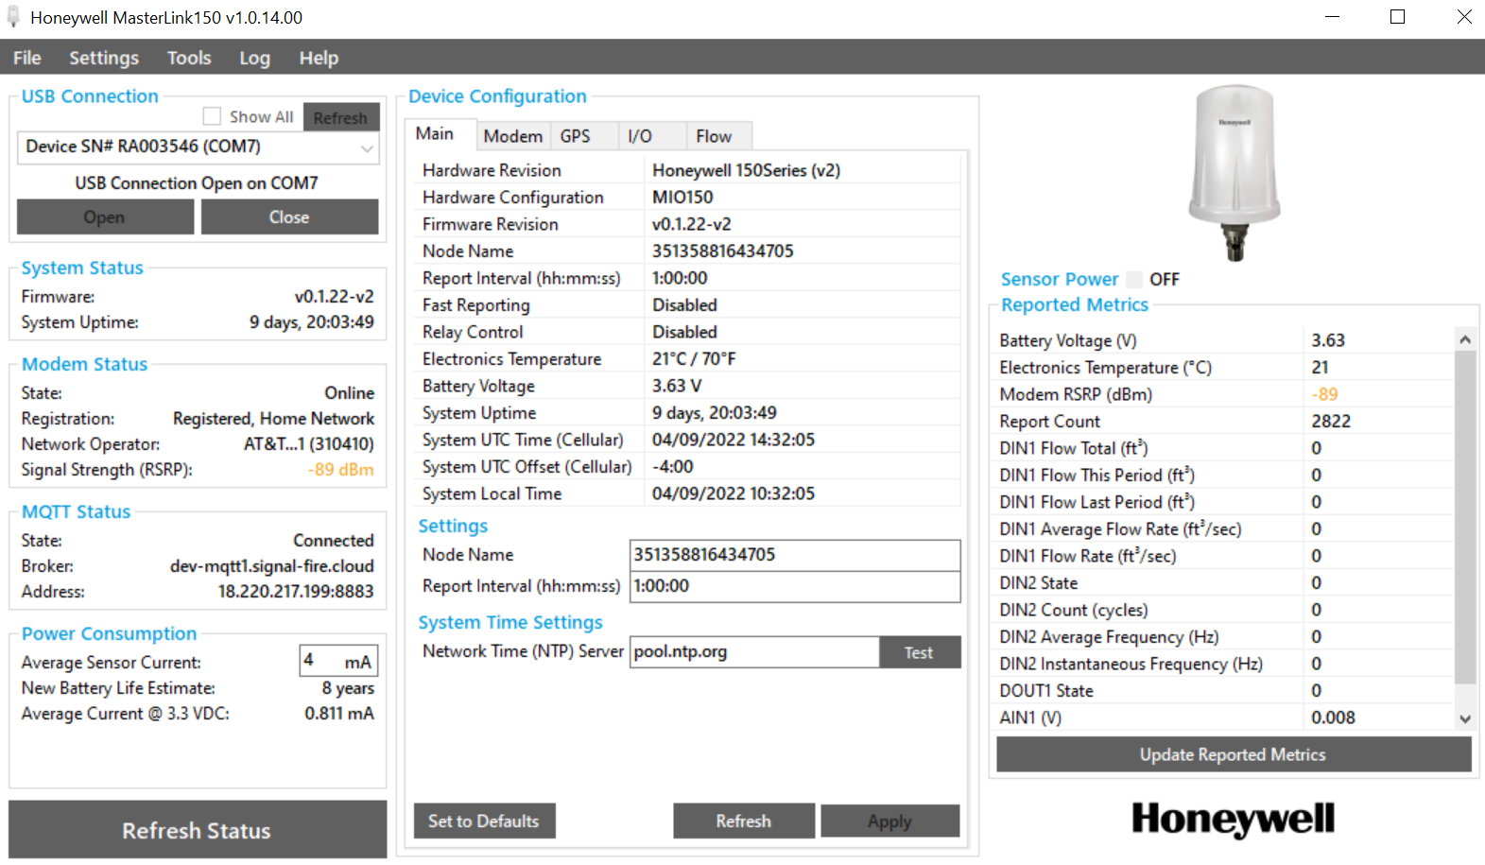
Easy Configuration

Slide 8


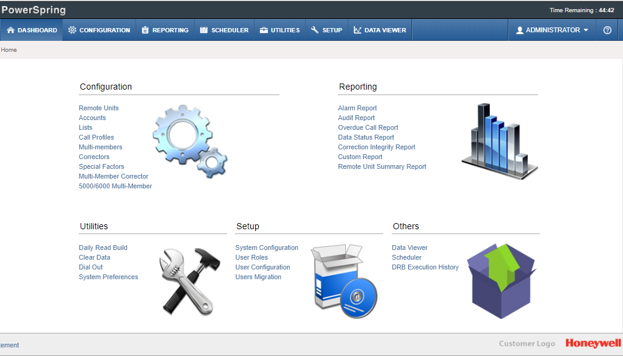





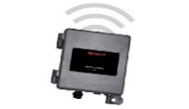
PowerSpring Deployment
DMZ
Utility / Corporate Network
DMZ
Dial-Out (IP)
PS Data Collection
(Mercury, DLMS)
Node - 1
PS Web Client
Web Server
Dial-In (IP)
Database Server
Https/SSL
PS Data Collection
(Mercury, DLMS, MQTT)
Node - 2
App Server
LAN
Web Server
PS Web Client
(Outside Utility network)
LAN
Dial-In (IP)
MQTT Broker
PS Data Collection
(Mercury, DLMS, MQTT)
Node - n
Publish
Dial-Out / Dial-In (IP)
Mercury Devices

Slide 9
PowerSpring Deployment
DMZ
Utility / Corporate Network
DMZ
Dial-Out (IP)
Dial-In (IP)
PS Data Collection
(Mercury, DLMS)
Node - 1
Web Server
PS Web Client
Dial-Out (IP)
Database Server
Dial-In (IP)
Https/SSL
MQTT Redundant Broker
(future)
PS Data Collection
(Mercury, DLMS)
Node - 2
App Server
(router, data processing, alarm handler, Dial Out)
Web Server
PS Web Client
(Outside Utility network)
Trusted connections through https communication
LAN
LAN
IP mapping,
Address translations
Publish Subscribe
MQTT Broker
White listing, port filtering
Traffic filtering
PS Data Collection
(MQTT)
Node - n
VPN
TLS Certificates
Publish
Subscribe
Dial-Out / Dial-In (IP)
Mercury Devices

Slide 10
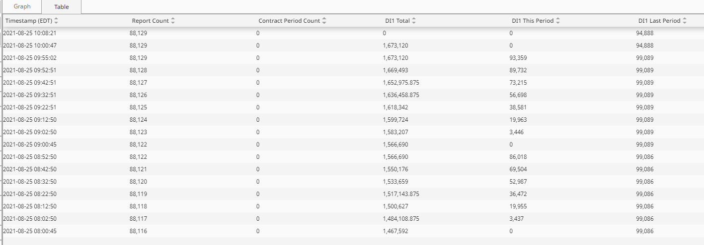

Slide 11
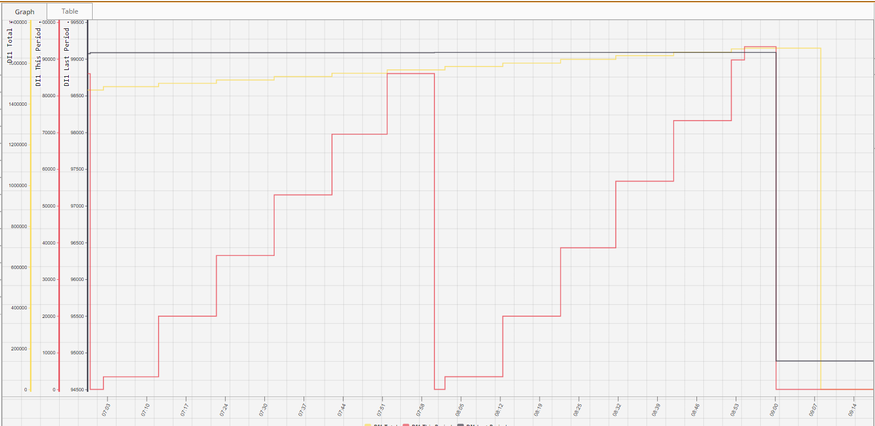

Slide 12

www.crwall.com
Calgary - CR Wall West Office
6143 4 St SE #15
Calgary, Alberta
Canada
T2H 2H9
403.255.3250
Waterloo - CR Wall East Office
640 Bridge Street, West
Waterloo, Ontario
Canada
N2K 4M9
519-624-9293

